Slide 1
Revelation 21:1-27
Lesson 31
the New Heavens and Earth
the New Jerusalem
from Heaven

Slide 2
The new Jerusalem coming down
out of Heaven from God, Rev 21:2
The holy city, new Jerusalem coming down out of heaven from God, Rev 21:2
Then John saw the holy city, new Jerusalem, coming down out of heaven from God,
(new Jerusalem) made ready as a bride adorned for her husband. Rev 21:9-10, 19:7-9,
The “new Jerusalem”, is a “holy city”, Rev 21:2, 21:10,
The “new Jerusalem”, is the name of the city, written by Jesus on overcomers (Believers), Rev 3:12,
The “new Jerusalem”, is a city that comes down out of heaven, Rev 21:2, 21:10, 3:12,
The “new Jerusalem”, is “the Jerusalem above is free; she (Jerusalem) is our mother” Gal 4:26
The “new Jerusalem”, is a city the heavenly Jerusalem, Heb 12:22
The “new Jerusalem”, is “made ready” or prepared by God, Rev 21:2, Rev 19:7-8
The “new Jerusalem”, is “as a bride adorned for her husband”. Rev 21:9-10, 19:7-9,
The “new Jerusalem”, is ‘the bride, the wife of the Lamb”, Rev 21:9-10
The “new Jerusalem”, is the ultimate destination of all the saints.
The “new Jerusalem”, is Not the Jerusalem of the Millennial Kingdom, it has passed away.
The “new Jerusalem” was made ready as a bride adorned for her husband. Rev 21:9-10, 19:7-9,
The city “was made ready”, as (personification) a bride adorned for her husband, is made ready.
Personification is
figurative language in which non-human things are described as having human attributes.
The city “was made ready”, in heaven, by being “adorned (beautified)”
for her husband (the Lamb), Rev 21:9.

Slide 3
New Jerusalem
out of Heaven from God, Rev 21:2
(Not to Scale)
The Holy City, New Jerusalem coming down out of Heaven from God, Rev 21:2

Slide 4
New Jerusalem
New Heavens
New Jerusalem
New Earth

Slide 5
The tabernacle of God
is among men, Rev 21:3
The tabernacle of God is among men, Rev 21:3
Then John heard a loud voice from the throne, saying, Rev 4:2, 4:9, 7:15, 21:5, 22:1, 22:3,
“Behold, the tabernacle of God is among men (on earth), Rev 7:15, 13:6, Heb 8:1-2,
A tabernacle is a “dwelling place”, and its meaning must be determined by
the context of how it is used.
the tabernacle (dwelling place) of God is (first) in heaven, where those in heaven dwell, Rev 13:6
and He (God) will dwell among them (men), Jn 14:23, 2 Cor 6:16, Lev 26:11, Ex 25:8, Ezek 37:27,
God will now dwell with men on earth, in the holy city, new Jerusalem.
and they (men) shall be His (God’s) people (men), 2 Cor 6:16, Jer 31:33, Rev 21:7
and God Himself will be among them (men), 2 Cor 6:16, Lev 26:12,
God dwelled with, Adam and Eve in the Garden, Gen 3:8
God dwelled with, the Nation of Israel, in a tabernacle, a sanctuary, Ex 25:8, Lev 26:11,
God dwelled with, the Nation of Israel, and was their God, and they were His people, Ezek 37:27
God dwelled with, “the Word (God) became flesh, and dwelt (tabernacled) among us”, John 1:14
God Promised to dwell among Believers, in the future,
“I will dwell in them and walk among them;
and I will be their God, and they shall be My people”, 2 Cor 6:16

Slide 6
“the Alpha and the Omega,
the First and the Last”
The Lord is: “the Alpha and the Omega, the First and the Last”
Isaiah 44:6
6 “Thus says the Lord, the King of Israel (43:15) and his Redeemer (43:14), the Lord of hosts:
‘I am the first and I am the last, And there is no God besides Me. Also Isa 41:4
Isaiah 48:12
12 “Listen to Me, O Jacob, even Israel whom I called; I am He, I am the first, I am also the last.
Revelation 2:8
8 “And to the angel of the church in Smyrna write:
The first and the last, who was dead, and has come to life, says this:
Revelation 21:6
6 Then He (Jesus) said to me, “It is done. I am the Alpha and the Omega, the beginning and the end.
Revelation 22:13
13 “I (Jesus) am the Alpha and the Omega, the first and the last, the beginning and the end.”

Slide 7
Overcomers: Rev 21:1–7
A New Heaven, a New Earth, and a New Jerusalem: Overcomers - Rev 21:1–7
“He who overcomes will inherit these things”, Rev 21:7
1. Overcomers, the tabernacle of God is among men, and He will dwell among them, Rev 21:3
2. Overcomers, they shall be His people, Rev 21:3
3. Overcomers, God Himself will be among them, Rev 21:3
4. Overcomers, He will wipe away every tear from their eyes; Rev 21:4
5. Overcomers, there will no longer be any death; Rev 21:4
6. Overcomers, there will no longer be any mourning, or crying, or pain; Rev 21:4
7. Overcomers, the first things have passed away.” Rev 21:4
8. Overcomers, “Behold, I am making all things new.” Rev 21:5
9. Overcomers, I will give to one who thirsts from spring of the water of life without cost, Rev 21:6
10. Overcomers, “He who overcomes will inherit these things (all listed), Rev 21:7
11. Overcomers, I will be his (overcomer’s) God and he (overcomer) will be My son, Rev 21:7
those who overcome the World, when Born of God, by Faith and Belief, 1 John 5:4–5

Slide 8
Overcomers: Rev 2 & 3
What the Spirit says to the Churches (7 assemblies), Rev 2 and Rev 3
1) Overcomers (1st) Church,
I will grant to eat of the tree of life in the Paradise of God. Rev 2:7
2) Overcomers (2nd) Church, He will not be hurt by the second death (Lake of Fire). Rev 2:11
3) Overcomers (3rd) Church,
I will give some hidden manna & a white stone with new name, Rev 2:17
4) Overcomers (4th) Church, I will give authority over the nations, Rev 2:26
a. Overcomers I will give him the morning star, Rev 2:28
5) Overcomers (5th) Church, He will thus be clothed in white garments, Rev 3:5
a. Overcomers I will not erase his name from the book of life, Rev 3:5
b. Overcomers I will confess his name before My Father and before His angels, Rev 3:5
6) Overcomers (6th) Church, I will make him a pillar in the temple of My God, Rev 3:12
a. Overcomers he will not go out from it (the temple) anymore, Rev 3:12
b. Overcomers I will write on him the name of My God, Rev 3:12
c. Overcomers (write on him) the name of the city of My God, New Jerusalem, Rev 3:12
d. Overcomers (write on him) My New Name, Rev 3:12
7) Overcomers (7th) Church, I will grant to him to sit down with Me on My throne, Rev 3:21
as I also overcame and sat down with My Father on His throne.

Slide 9
New Jerusalem
1200 Stadia (1378 miles)
1200 Stadia (1378 miles)
The City,
Pure Gold,
Like Crystal Clear Jasper
Rev 21:11, 21:18
1200 Stadia (1378 miles)
Wall,
Jasper
144 cubits
(216 feet)
Rev 21:17-18
12 Gates of Pearl
12 Angels
12 Tribes Names
Rev 21:12
12 Foundation Stones
12 Apostles Names
Rev 21:14
(Not to Scale)
Notice: the Gates and 216 foot high Walls on a 1378 mile high City
would barely be visible if drawn to proper Scale.

Slide 10
The New Jerusalem City - Exterior
The New Jerusalem City Exterior Described: Rev 21:12-14
The City had a great and high (216’) Wall, 21:15, on All 4 sides.
The (216’) Wall had 12 Gates, 21:15, 21:21, 21:25, 22:14, like Ezekiel’s City, Ezek 48:30-34
The (216’) Wall Gates had 12 Angels; probably stationed there to greet or monitor those who entered.
The (216’) Wall Gates had Names were written on them,
the Names of the 12 tribes of the sons of Israel, like Ezekiel’s City, Ezek 48:30-34.
But the New Jerusalem is Not Ezekiel’s City, it is much smaller, only 6750’ on each side.
It doesn’t say which Tribe Name of Israel is on what Gate,
possibly could be from Rev 7:4-8 or Ezek 48:30-34.
The (216’) Wall had 3 Gates on the east, 3 Gates on the north, 3 Gates on the south,
and 3 Gates on the west.
The (216’) Wall of the city had 12 foundation stones, probably layered as shown, Heb 12:10,
with the 12 names of the 12 apostles of the Lamb, with one name per Stone.
It doesn’t say which apostle is on what Stone, probably the eleven, Acts 1:13,
and Matthias, Acts 1:26.
The New Jerusalem City Exterior Described: Rev 21:15-21
The Angel had a gold measuring Rod to measure the City, it was laid out square,
The City’s Length, Width, and Height was (12,000 stadion, 1378 miles);
The City’s Walls were (144 cubits, 216 feet), probably the Height, adorned with
every kind of precious stone.
The City has 12 Gates and each Gate was a single pearl,
The City’s Street was pure gold, like transparent glass.

Slide 11
1200 Stadia = 1378 miles > Rev 21:16
Gate
Gate
Gate
344 miles
New Jerusalem
1200 x 1200 x 1200 stadia
(1378 x 1378 x 1378 miles)
North
Gate
The City was, Pure Gold, Like Clear Glass, Rev 21:11, 18, 21
No Temple, Rev 21:22
Glory of God illuminates, Rev 21:22
Gate
344 miles
WEST
EAST
1200 Stadia = 1378 miles > Rev 21:16
12 Gates of Pearl
12 Angels, at Gates
12 Tribes Names
Rev 21:12-13
Wall,
144 cubits,
216 feet
Rev 21:17
Gate
Gate
344 miles
Gate
City Street was,
Pure Gold, Like Clear Glass, Rev 21:21
Gate
344 miles
Gate
Gate
Gate
SOUTH

Slide 12
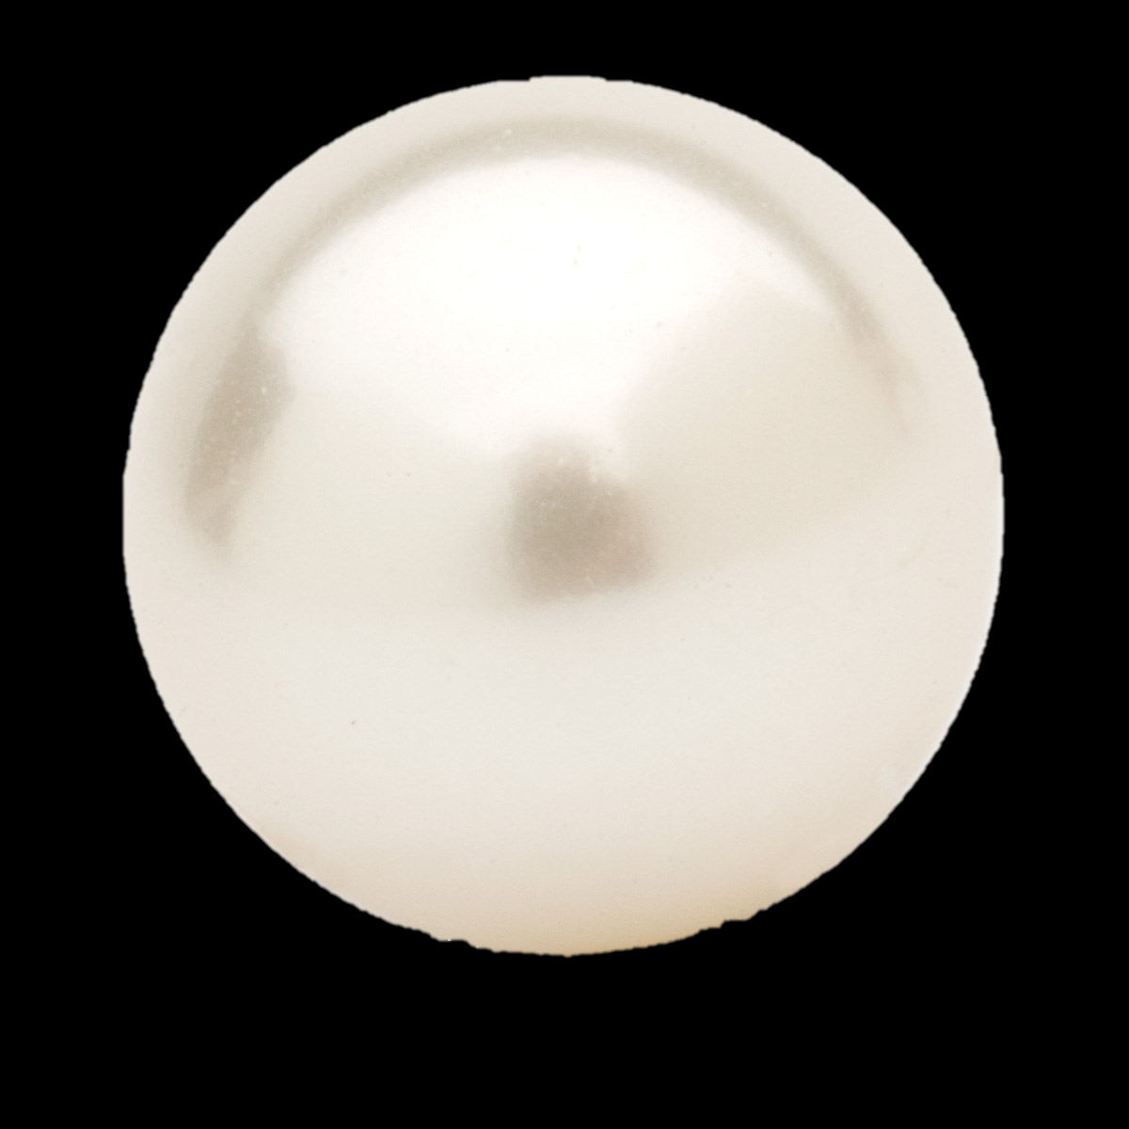
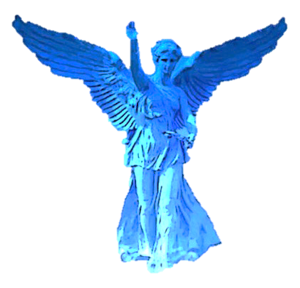
Pearl Gates - to City
Wall, 144 cubits (216 feet), material was Jasper, Rev 21:17-18
12 Gates, each was a single Pearl, Rev 21:12-13, 21:21
Gates are never closed, Rev 21:25
12 Angels, at the Gates, Rev 21:12
12 Tribes Names, written on Gates, Rev 21:12
Gate to City
Only those who wash their robes
may enter by
the Gates
into the City.
Rev 22:14, 19:8
Pearl Gate
Tribe of Israel Name
Never Closed
Angel, Rev 21:12
Foundation Stones
12 Foundation Stones, with 12 Apostle’s Names, Rev 21:14

Slide 13
The City, Nations, and Kings of earth
The City and the Nations and the Kings of the earth, Rev 21:24
24 The nations will walk by its (City’s) light, Rev 21:26, Isa 60:3,
the nations or “the peoples” the redeemed people from every nation (Jew and Gentile)
will dwell and walk in the light from the Lord Himself, in the eternal city.
Also, the kings of the earth will bring their glory into it (the City). Rev 21:24
All people in eternity become the people of God, and they will move freely in and about the city.
the redeemed people, those in Christ, 1 Thes 4:13-18
the redeemed people, who came out of the great tribulation, Rev 7:9-17
the redeemed people, the 144,000 of every tribe of Israel, Rev 7:3-8, 14:1-5
the redeemed people, those martyred during the 7 year tribulation, Rev 20:4-6
the redeemed people, the Old Testament saints, Dan 7:18, 7:22, 7:27
the redeemed people, those whose names are written in the Lamb’s book of life, Rev 21:27

