Slide 1
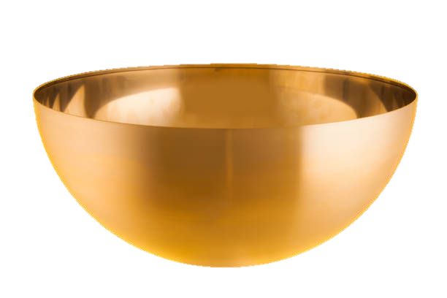
Revelation 15:1–8
Revelation 16:1–21
Lesson 24
The 7 Bowl Judgments
allscriptureinspired.com
Kevin E. Hughes

Slide 2
The 21 Judgments of the Scroll
Scroll > includes the 7 Seal, 7 Trumpet, and 7 Bowl Judgments
1st
Seal
2nd
Seal
3rd
Seal
4th
Seal
5th
Seal
6th
Seal
7th
Seal
7th Seal > includes 7 Trumpet and 7 Bowl Judgments
1st
Woe
2nd
Woe
3rd
Woe
1st
Trumpet
2nd
Trumpet
3rd
Trumpet
4th
Trumpet
5th
Trumpet
6th
Trumpet
7th
Trumpet
7th Trumpet > includes 7 Bowl Judgments
1st
Bowl
2nd
Bowl
3rd
Bowl
4th
Bowl
5th
Bowl
6th
Bowl
7th
Bowl
The Scroll has 7 Seals of Judgment
The Scroll includes the 7 Seal, the 7 Trumpet, and the 7 Bowl Judgments
The 7th Seal includes the 7 Trumpet and the 7 Bowl Judgments
The 7th Trumpet includes the 7 Bowl Judgments

Slide 3
The Scroll with the 7 Seals
The Scroll with 7 Seal Judgments
6 Seals
7th Seal
6 Trumpets
7th Trumpet
7 Bowls
The Scroll has 7 Seals of Judgment
The Scroll includes the 7 Seal, the 7 Trumpet, and the 7 Bowl Judgments
The 7th Seal includes the 7 Trumpet and the 7 Bowl Judgments
The 7th Trumpet includes the 7 Bowl Judgments

Slide 4
Wrath of God, by Plague Judgments
The Wrath of God, Foretold and Carried out, by Plague Judgments
The first Plagues were the 6 Seal Judgments, the wrath of God, Rev 6:1-17
Then the 7 Angels are given 7 Trumpets, Rev 8:2
Then, when 7th Angel is about to sound, then the mystery of God is (about to be) finished, Rev 10:7
The next Plague was the 7th Seal Judgment that included, the 7 Trumpet Judgments, Rev 11:15
Then (foretold) the time came for judging the Dead, rewarding Saints, and destroy the Earth, Rev 11:18
Then (foretold) the Beast will receive the wrath of God, with fire and brimstone, Rev 14:10
Then (foretold) 2 Angels will Harvest, Reap, and Crush the Earth dwellers, by wrath of God, Rev 14:19
Then (foretold) the 7 plagues are the last, because in them the wrath of God is finished, Rev 15:1
Then the 7 Angels are given the 7 golden Bowls full of the wrath of God, Rev 15:7
Then the 7 Angels are told to pour out on the Earth the 7 Bowls of the wrath of God, Rev 16:1
Then the 7th Angel poured out his Bowl, a voice from throne, says, It (wrath of God) is done, Rev 16:17
God often Foretells and Reveals what in about to occur,
in the sense that it has already occurred,
it is assumed done, because it is foreordained certainty.

Slide 5
Comparing Trumpet and Bowl Judgments
Comparing the 7 Trumpet Judgments with the 7 Bowl Judgments
The 7 Trumpet Judgments partially Destroy (1/3) Parts of the Earth
and the 7 Bowl Judgments completely Destroy (All) Parts of the Earth
I. Lamb broke the 7th SEAL, Silence in Heaven for about 1/2 Hour, (8:1),
1. 7 Angels given 7 Trumpets, 8:2, 8:6
2. 7 Angels with 7 Bowls, in them the Wrath of God is Finished, 15:1, “It is done”, (16:17)
1. 1st Trumpet, Fire mingled with Blood, 1/3 of Earth and 1/3 of Trees and Grass Burnt up, (8:7)
2. 1st Bowl, On Earth, Sores on Men, with Mark of the Beast, (16:2), like (16:10-11)
1. 2nd Trumpet, Burning Mountain cast into Sea, 1/3 of Sea Creatures Die, 1/3 of Ships Destroyed,
1/3 of Sea becomes Blood, (8:9-10)
2. 2nd Bowl, on Sea, Sea became Blood, All Sea Creatures Die, (16:3)
1. 3rd Trumpet, Burning Star Wormwood, falls on 1/3 of Rivers and 1/3 of Waters, (8:10-11)
2. 3rd Bowl, All Rivers and Waters become Blood, (16:4-7)
1. 4th Trumpet, 1/3 of Sun, 1/3 of Moon, 1/3 of Stars and 1/3 of Day smitten/darkened, (8:12)
Woe, Woe, Woe, (8:13)
2. 4th Bowl, on Sun, All Men scorched with Fire, (16:8-9)
1. 5th Trumpet, (1st Woe), the Sun and Moon Darkened by smoke from Pit. (9:1-2)
Locust (Demons) Torment Unsealed Men, 5 mo., (9:3-12)
2. 5th Bowl, on Throne of the Beast, his Kingdom Darkened, pains and sores, (16:10-11) like (16:2)
1. 6th Trumpet, (2nd Woe), 4 Demon Angels at River Euphrates, 1/3 of Mankind Killed, (9:13-21)
Mankind Killed by Fire, by Smoke, and by Brimstone, (9:18)
2. 6th Bowl, on River Euphrates, River dried up, for Armageddon armies, (16:12-16)
1. 7th Trumpet, (3rd Woe), the Kingdom of the World has become the Kingdom of Christ, (11:15
Lightning, Thunder, Earthquake, Hail, (11:19)
2. 7th Bowl, poured on the Air, with Lightning, Thunder, Earthquake, Hail, (16:17-21)
All Islands fled away and Mountains Not Found
7th Bowl, the Wrath of God is Finished, 15:1, “It is done”, (16:17)

Slide 6
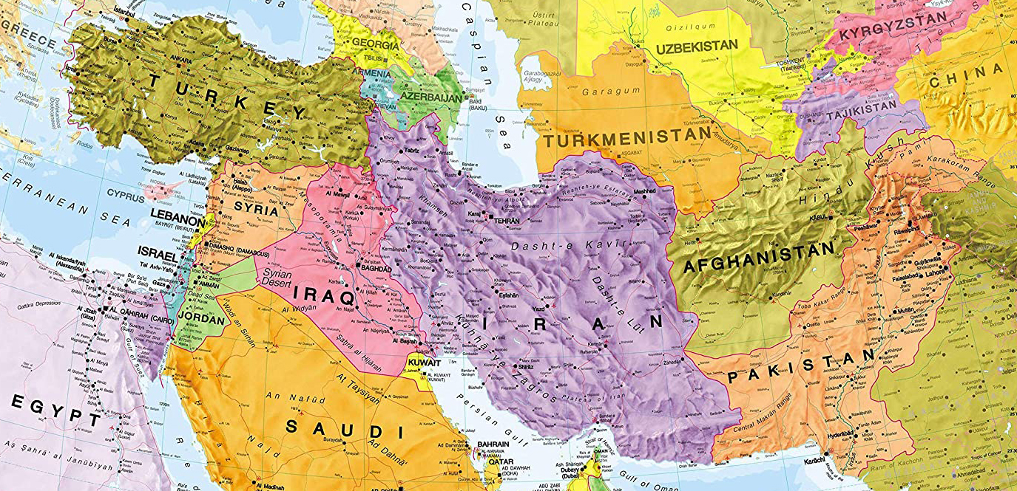
“the Kings (Kingdoms) from the east”
Revelation 16:12
Russia
Kings from the East
Babylon

Slide 7
Behold, I am coming like a thief, Rev 16:15
Behold, I am coming like a thief, Rev 16:15
“Behold, I (Jesus) am coming like a thief, meaning unexpectedly, as when you are sleeping, not alert.
This is “the Day of the Lord” as referred to by Paul, Peter, and Jesus, in Rev 3:3, 3:11, 1 Thes 5:2-4, 2 Pet 3:10
Revelation 3:3
3 ‘So remember what you have received and heard; and keep it, and repent.
Therefore if you do not wake up,
I will come like a thief, and you will not know at what hour I will come to you.
1 Thessalonians 5:2–4
2 For you yourselves know full well that the Day of the Lord will come just like a thief in the night.
3 While they (unbelievers) are saying, “Peace and safety !” then destruction will come upon them
suddenly like labor pains upon a woman with child, and they (unbelievers) will not escape.
4 But you, brethren, are not in darkness, that the day (of the Lord) would overtake you like a thief;
2 Peter 3:10
10 But the Day of the Lord will come like a thief, in which the heavens will pass away with a roar
and the elements will be destroyed with intense heat,
and the earth and its works will be burned up.
Matthew 24:42–43
42 “Therefore be on the alert, for you do not know which day your Lord is coming.
43 “But be sure of this, that if the head of the house had known at what time of the night
the thief was coming, he would have been on the alert and would not have allowed
his house to be broken into.

