Slide 1
Revelation 3:1-22
Lesson 08
allscriptureinspired.com
Kevin E. Hughes

Slide 2
Mystery in Revelation 1:20
Pattern of Mystery, Rev 1:20
Mysteries of God
Kept Secret
Mystery Hidden
Things
Unknown
Mystery Presented
by Metaphor
Mystery Revealed
Interpreted
Literally
Mystery Understood Literally
Mysteries > Hidden Things or Kept Secret Things of God
Mysteries in the Bible are those things revealed by God,
that were previously hidden by God.
Romans 16:25–26

Slide 3
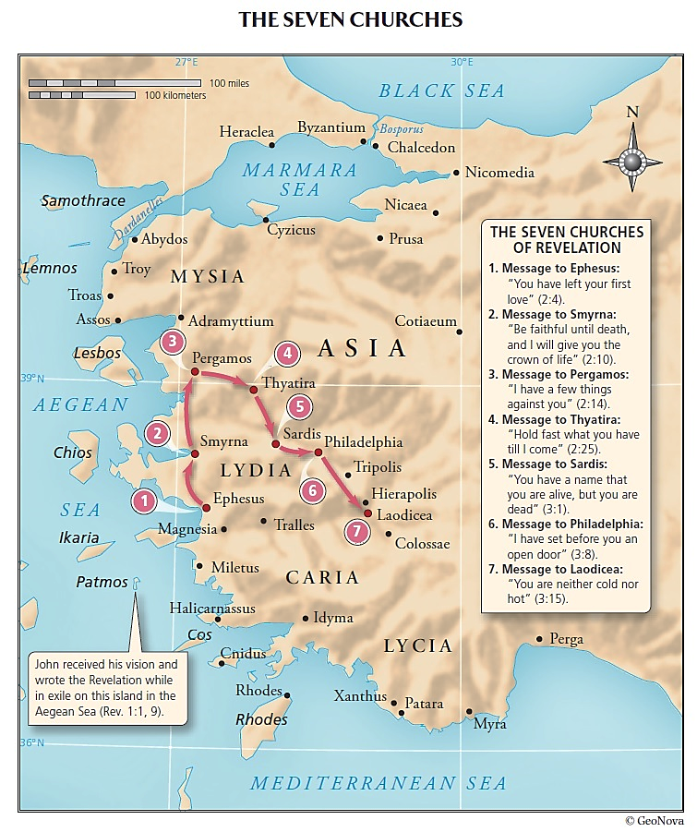

Slide 4
White Garments, Robes,
Clothes, or Coverings - Rev 3:4-5
Clean White Fine Linen Robes
Those Born of God or Overcomers
will be Given by God Clean White Fine Linen Robes, Rev 3:5
Because they are Worthy and have Overcome the World by Faith and Belief in Jesus,
Rev 3:4-5, 1 John 5:4–5
Because they were Washed, Sanctified, and Justified with the Blood of Lamb,
Rev 7:15, 1 Cor 6:11
Because of the Blood of Lamb, their Sins are Forgiven and they are Reconciled to God,
1 Col 1:21-22

Slide 5
The Book of Life of the Lamb - Rev 3:5
The Book of Life
Overcomers (Saved Believers)
will Not have their names erased from the Book of Life
This implies that Overcomers (Saved Believers)
have their names in the Book of Life
The Book of Life of the Lamb - Rev 13:8
The Book of Life
All who dwell on the earth (earth dwellers) will worship him (the Beast, AntiChrist)
everyone whose name has not been written ……..
from the foundation of the world
everyone WHO (Unbelievers) doesn’t have their name written
from the foundation of the world
everyone WHO (Believers) do have their name written
from the foundation of the world
This tells us WHEN certain people have their names written
in the book of life of the Lamb
This implies there is a book of life of the Lamb (Jesus), and that Jesus has that Book

Slide 6
The Book of Life of the Lamb - Rev 17:8
The Book of Life
those who dwell on the earth (earth dwellers)
will wonder when they see the beast (AntiChrist)
those WHO (Unbelievers) don’t have their name written
from the foundation of the world
The Book of Life of the Lamb –
Rev 20:12–15
The Book of Life
Books were opened, before the Throne (of Him Jesus, 21:11)
another book was opened, which is the book of life, before the Throne
anyone WHO (Unbelievers) doesn’t have their name written in the book of life,
is thrown into the lake of fire
This implies the book of life records who will NOT be thrown into the lake of fire

Slide 7
The Book of Life of the Lamb –
Rev 21:27
The Book of Life
Only those whose names are written in the Lamb’s book of life,
those clean, shall come into New Jerusalem
The Book of Life of the Lamb
Conclusion
The Book of Life
There is a Book, called the Book of Life, that belongs to the Lamb Jesus, Rev 13:8, 21:27
This Book of Life of Jesus
was written or prepared from the foundation of the world, Rev 13:8, 17:8
This Book of Life of Jesus
only has the names of Overcomers or Believers written in it, Rev 3:5, 21:27
This Book of Life of Jesus
determines who will be allowed to come into the New Jerusalem, Rev 21:27
This Book of Life of Jesus
is used by Jesus to Judge Unbelievers that leads to the lake of fire, Rev 20:15

Slide 8
I (Jesus) Will Come Like a Thief
I (Jesus) will come like a thief, Rev 3:3
I (Jesus) will come like a thief, Rev 3:3, 16:15, 1 Thes 5:15, 2 Pet 3:10, Matt 24:43–44, Lk 12:39-40
if you do not wake up, I (Jesus) will come like a thief, Rev 3:3
you will not know at what hour I will come to you. Rev 3:3, Matt 24:43–44, Matt 25:13
I (Jesus) am Coming like a thief, Rev 16:15
I (Jesus) am coming like a thief
the one who stays awake and keeps his clothes, so that he will not walk naked, not shamed
Clothes Cover Shame (Self-Conscience feeling of Guilt) OR Cover Nakedness (Guilt Not revealed)
Adam and Eve were First Naked and Not Ashamed, Gen 2:25,
and Then Naked and Ashamed, Gen 3:7-11]

Slide 9
The Day of the Lord will come
just Like a Thief in the Night
the day of the Lord will come
just like a thief in the night, 1 Thes 5:1–11
Brethren (believers), the day of the Lord will come just like a thief in the night. 1 Thes 5:2
they (unbelievers) are saying, “Peace and safety!” then destruction will come upon them, 1 Thes 5:3
they (unbelievers) will not escape, 1 Thes 5:3
You, brethren, are not in darkness, that the day would overtake you like a thief, 1 Thes 5:4
let us not sleep as others do, but let us be alert and sober. 1 Thes 5:6
those (unbelievers) who sleep do their sleeping at night, 1 Thes 5:7
God has not destined us for wrath,
but for obtaining salvation through our Lord Jesus Christ, 1 Thes 5:9
God has not destined us (believers) for His wrath or His Righteous Anger and Punishment

Slide 10
The Day of the Lord will come
just like a Thief
the day of the Lord will come just like a thief, 2 Peter 3:10–12
the day of the Lord will come, 2 Pet 3:10
the heavens will be destroyed by burning, the elements will melt with intense heat! 2 Pet 3:10
the heavens will pass away, the earth will be burned up. 2 Pet 3:10
all these things (heaven and earth) are to be destroyed in this way (burning), 2 Pet 3:11
The time of the night the thief was coming, Matt 24:42–44
the thief is coming, be on the alert and be ready, Matt 24:43, 25:13, Rev 3:3
you (Israel) also must be ready Matt 24:44
the Son of Man is coming at an hour when you do Not think He will, Matt 24:44, Lk 12:40

Slide 11
I (Jesus) Will Come Like a Thief Conclusion
I (Jesus) will come like a thief,
Rev 3:3, 16:15, 1 Thes 5:2, 2 Pet 3:10, Matt 24:43–44, Lk 12:39-40
“Like a thief” is a Simile Metaphor, Jesus is Compared to a thief
Thieves Come at an hour when you do Not think they will.
Jesus will Come at an hour when you do Not think He will,
Matt 24:44, Lk 12:40

Slide 12
Believers
are NOT Subject to God’s Wrath
Believers, God’s People, are NOT subject to God’s Wrath
Believers, God’s People, were NOT subject to God’s Wrath > in Noah’s Flood, Lk 17:26-27
Believers, God’s People, were NOT subject to God’s Wrath > in Sodom and Gomorrah, Lk 17:28-29
Believers, God’s People, will NOT be subject to God’s Wrath > at His Second Coming, Lk 17:30
Believers, God’s People, are (destined) for salvation (deliverance from punishment + sin), 1 Thes 5:9
Believers, God’s People, will NOT be subject to God’s Wrath >
Because only for His adversaries and His enemies, Nahum 1:2
Because Jesus will deal out retribution to those (unbelievers) who do not know God, 2 Thes 1:6–10
Because Jesus will execute judgment upon all ungodly sinners, Jude 14–15
WHY are Believers Delivered from Punishment and Sin ?
so that (purpose) whether we are awake or asleep, we will live together with Him.” 1 Thes 5:11
“Therefore (for that Reason) encourage one another and build up one another,
just as you also are doing.” 1 Thes 5:11
WHY encourage one another ?
Because Believers, God’s People, will be Delivered from Punishment and Sin, 1 Thes 5:9
HOW do we know that we will be Delivered from Punishment and Sin ?
Because Paul said we would, 1 Thes 5:9

Slide 14
I will keep you from
the hour of testing, Rev 3:10-11
I will keep you from the hour of testing,
of those who dwell on the earth (earth dwellers)
“those who dwell on the earth”
Refers to: Unbelievers and Not Believers and Not the Church, Rev 17:8
Refers to: those who dwell on the earth,
whose name has not been written in the book of life, Rev 17:8
Refers to: those Unbelievers who are judged/punished
and subject to the wrath of God
Refers to: those Unbelievers in the Book of Revelation, 6:10, 8:13, 11:10, 13:14, 17:2, 17:8
Refers to: those Unbelievers who receive the Judgements in Revelation
those who dwell on the earth (earth dwellers), are Unbelievers

Slide 15
I will keep you from
the hour of testing, Rev 3:10-11
that hour which is about to come upon the whole world
on those who dwell on the earth
“that hour which is about to come upon the whole world” Rev 3:10
Refers to: Events in Revelation 6 thru Revelation 19
concerning God’s Judgement on Men and Earth
Refers to: a Time of “Tribulation” before Jesus’ Second Coming,
Matt 24:21, 24:29
Refers to: a Time before the Son of Man Comes with Power and Great Glory,
Matt 24:30, Lk 21:27

Slide 16
Believers
are NOT Subject to God’s Wrath
Believers, God’s People, were and are NOT subject to God’s Wrath
Believers, God’s People,
were NOT subject to God’s Wrath > in Noah’s Flood, Lk 17:26-27
Believers, God’s People,
were NOT subject to God’s Wrath > in Sodom and Gomorrah, Lk 17:28-29
Believers, God’s People,
will NOT be subject to God’s Wrath > at His Second Coming, Lk 17:30
Believers, God’s People,
are (destined) for salvation (deliverance from punishment + sin), 1 Thes 5:9
(saved) so that (purpose) whether we are awake or asleep,
we will live together with Him.” 1 Thes 5:11
Believers, God’s People, will NOT be subject to God’s Wrath >
Because only for His adversaries and His enemies, Nahum 1:2
Because Jesus will deal out retribution
to those (unbelievers) who do not know God, 2 Thes 1:6–10
Because Jesus will execute judgment upon all ungodly sinners, Jude 14–15

