Slide 1
Revelation 1:9-20
Lesson 06
allscriptureinspired.com
Kevin E. Hughes

Slide 2
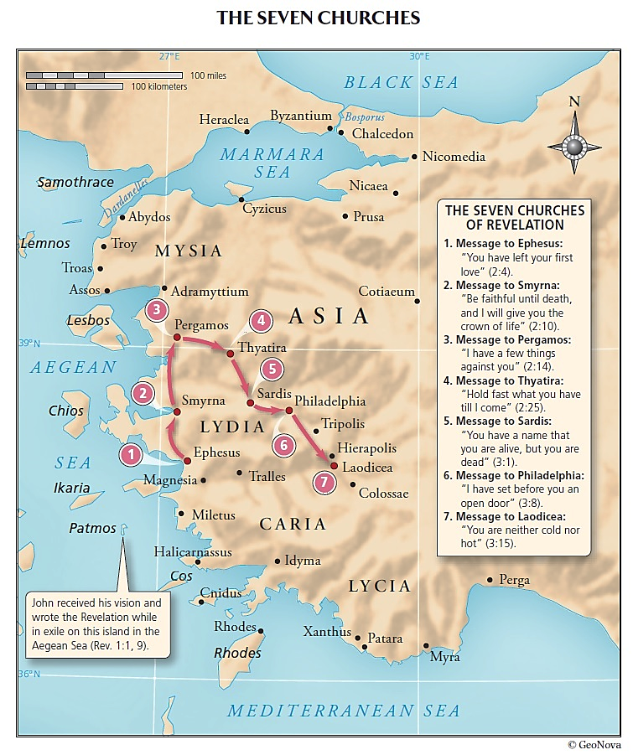

Slide 3
Interpretation of Prophecy - Keys
Personification Metaphor, a Figure of Speech
Interpretation of Prophecy Key: A Personification, a Type of Metaphor, a Figure of Speech “Personification is a figure of speech in which an idea or thing is given human attributes and/or feelings
or is spoken of as if it were human. Personification is a common form of metaphor in that human characteristics
are attributed to nonhuman things.” https://literarydevices.net/personification/
All Figures of Speech in Bible, are Non-Fictional, and Have a Literal Intent, K. E. Hughes
Figures of Speech
Interpretation of Prophecy Key: “Figure of Speech, any intentional deviation from
a literal statement or common usage that emphasizes, clarifies, or embellishes
both written and spoken language.” https://www.britannica.com/art/figure-of-speech
All Figures of Speech in Bible, are Non-Fictional, and Have a Literal Intent, K. E. Hughes
See “Revelation Introduction – Part 04”
for more on Figures of Speech

Slide 4
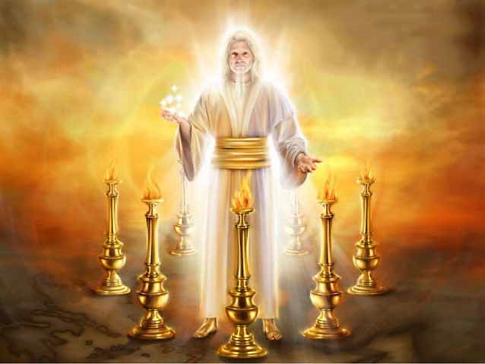

Slide 5
Interpretation of Prophecy - Key
Simile Metaphor, a Figure of Speech
Interpretation of Prophecy Key: A Simile, a Type of Metaphor, a Figure of Speech
“A Simile is a figure of speech in which two essentially dissimilar objects or concepts are expressly
compared with one another through the use of “like” or “as.” https://literarydevices.net/simile/
All Figures of Speech in Bible, are Non-Fictional, and Have a Literal Intent, K. E. Hughes
See “Revelation Introduction – Part 04”
for more on Figures of Speech

Slide 6
Interpretation of Prophecy - Key
Prophecy Often Interprets itself
Interpretation of Prophecy Key: Prophecy Often Interprets itself
In Revelation, as in the OT and Gospels, a Vision, Mystery, or Figure of Speech is often presented,
and then its Literal interpretation is given in the following Text or Near Context by the Author.
All Visions, Mysteries, and Figures of Speech in Bible, are Non-Fictional, and Have a Literal Intent,
K. E. Hughes
See “Revelation Introduction – Part 04”
for more on Figures of Speech

Slide 7
John “bore witness to” “all that he saw” in Revelation
“John who bore witness to” “to all that he saw”, Rev 1:1-2
John Bears Witness “to all that he saw”, in entire Book of Revelation
John “write in a book what you see” in Revelation
John “write in a book what you see”, in entire Book of Revelation, Rev 1:11
Then John “turned to see” the son of man
John “turned to see the voice speaking with me”, Rev 1:12a
John “having turned I saw seven lampstands”, Rev 1:12b
John “having turned I (saw)”…. the “one like the son of man”, Rev 1:12b
John “when I saw Him”, Rev 1:17
Then John “write therefore the things which you have seen”
John “write therefore the things which you have seen” Rev 1:19a
John was to write what he “turned to see”
John “turned to see” “the son of man”, Rev 1:12-18

Slide 8
John “write therefore”
“write therefore the things which you have seen”
John “write therefore the things which you have seen” Rev 1:19a
“and (write) the things which are”
John “(write) the things which are” Rev 1:19b
“and (write) the things which shall take place after these things”
John “(write) the things which are” Rev 1:19b
“You use therefore to introduce a logical result or conclusion”, Collins Dictionary
Therefore here is Command a conjunction in Greek, but an adverb in English.
Therefore conjunction, “For that Reason” based on what was just said previously.

Slide 9
Revelation - Big Picture of Events
Revelation - Big Picture of Events
Rev 1:19
Rev 1:19
Rev 1:19, Rev 4:1
“the things
which you have seen”
“The things
which are”
“The things
which will take place after these things”
PAST things, “seen”
PRESENT things, “are”
FUTURE things, “will”, Prophetic Events
Vision/Words of Jesus
7 Churches in Asia
Throne
& Scroll
Tribulation
Second Coming
Millennial
Kingdom
Eternal
State
1:1
2:1
4:1
6:1
19:11
20:1
21:1
22:17
Rev 1
Rev 2 & Rev 3
Rev 4:1 - Rev 22:17

Slide 10
Revelation – Vision/Words of Jesus
The Revelation, the Greeting, and the Vision
“the things which you have seen”
PAST things, “seen”, in First Century
Vision/Words of Jesus
1:1
1:20
Rev 1
The Revelation of Jesus
The Greeting of John
The Vision of John
1:1
1:4
1:9
1:20

Slide 11
Revelation – 7 Churches
7 Churches
“The things which are”
PRESENT things, which “are”, in First Century
7 Churches in Asia
2:1
3:22
Rev 2 & Rev 3
Church in Ephesus
Church in Smyrna
Church in Pergamum
Church in Thyatira
Church in Sardis
Church in Philadelphia
Church in Laodicea
2:1
2:8
2:12
2:18
3:1
3:7
3:14
3:22

Slide 12
Revelation - Prophetic Events
The Scroll, Tribulation, Second Coming, Millennium, Eternal State
“The things which will take place after these things”
FUTURE things, “will take place”, Prophetic Events
Throne
& Scroll
Tribulation > 7 Seals, 7 Trumpets, and 7 Bowl Judgments
Second Coming
Millennial
Kingdom
Eternal
State
4:1
6:1
19:11
20:1
21:1
22:17
Rev 4:1 - Rev 22:17
Judgments: on Men and on Earth
Judgments on Men, 6 Seals, Rev 6
Judgment on Earth, Trumpets 1-4, Rev 8:7-13
Judgment on Men, Trumpets, 5-6, Rev 9:1-21
Judgment in War in Heaven, Rev 12:7-12
Judgment in War on Earth, Rev 12:13 - 13:18
Judgment on Men and Earth, Bowls 1-7, Rev 16:1-21
Judgment on Earth, on Babylon, Rev 17 & 18
Judgment as Final Judgment on Man, Rev 19:11-21
The Millennium, Rev 20:1-6
Judgment of Sinners, Rev 20:11-15
Eternal State, Rev 20:11-15
A Major Theme of Revelation:
Judgment

Slide 13
Interpretation of Prophecy - Key
Prophecy Often Interprets itself
Interpretation of Prophecy Key: Prophecy Often Interprets itself
In Revelation, as in the OT and Gospels, a Vision, Mystery, or Figure of Speech is often presented,
and then its Literal interpretation is given in the following Text or Near Context by the Author.
All Visions, Mysteries, and Figures of Speech in Bible, are Non-Fictional, and Have a Literal Intent,
K. E. Hughes
See “Revelation Introduction – Part 04”
for more on Figures of Speech

