Slide 1
Revelation 13:1-18
Lesson 22
The Beast out of the Sea
and
the False Prophet
allscriptureinspired.com
Kevin E. Hughes

Slide 2
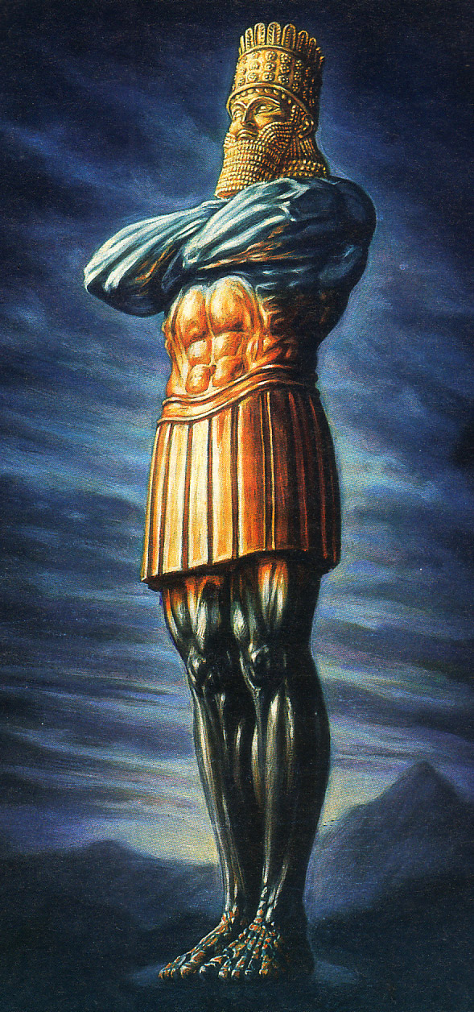
1st Babylonian Empire
605 - 539 BC
History
Gentile
2nd Medo-Persian Empire
539 - 331 BC
History
Gentile
3rd Grecian Empire
331 - 168 BC
History
Gentile
4th United Roman Empire
168 BC - 476 AD
History
Gentile
Gap of Time – from 476 BC
to the “days of those Kings”, Dan 2:44
Age of
Gentiles
K
K
K
K
K
Future
5th Divided Toe Empires
Gentile
K
K
K
K
K
6th Everlasting Kingdom
God, Sets Up a Kingdom that will
“Endure Forever”- “Take Place in Future”
Future
Israel

Slide 3
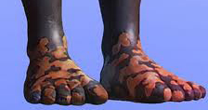
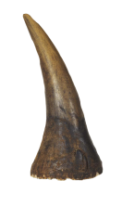
Daniel and Revelation
Daniel 2:1-45
10 Toes, Dan 2:41, 42
10 Kings, Dan 2:44
Daniel 7:1-12
10 Horns, Dan 7:7, 20, 24
10 Kings, Dan 7:24
Revelation 12:3
10 Horns, Rev 12:3
7 Diadems (Crowns), Rev 13:1
Revelation 13:1-10
10 Horns, 13:1
10 Diadems (Crowns), Rev 13:1
Revelation 17:1-18
10 Horns, Rev 17:3, 7, 12, 16
10 Kings, Rev 17:12

Slide 4
Antichrist at the Beginning of
the Great Tribulation
The Antichrist at the Beginning of the 3 1/2 Year Great Tribulation
This is when the New Jewish Temple in Jerusalem has been built during the first 3 ½ years of the Tribulation.
This is when the Antichrist breaks his 7 year Covenant with Israel after 3 ½ years. Dan 9:27,
This is when the abomination of desolation occurs in the Temple, Dan 11:31, 12:11, Matt 24:15, 2 Thes 2:4
This is when the Antichrist will set up the abomination of desolation, Dan 11:31, Dan 12:11
This is when the abomination of desolation, is standing in the holy place (Temple), Matt 24:15
This is when the Antichrist desecrates the sanctuary fortress (Temple), Dan 11:31,
This is when the Antichrist does away with the regular sacrifice of Israel, Dan 11:31, Dan 12:11
This is when the Antichrist, the man of lawlessness, comes first before the Day of the Lord, 2 Thes 2:3
This is when the Antichrist, the man of lawlessness, is revealed, the son of destruction, 2 Thes 2:3
This is when the Antichrist, is Not restrained anymore and he is revealed, 2 Thes 2:6
This is when the Antichrist, is according to the activity of Satan with signs and false wonders, 2 Thes 2:9
This is when the Antichrist, comes with all deception of wickedness for those who perish, 2 Thes 2:10
This is when God sends on them a deluding influence so they might believe what is false, 2 Thes 2:11
This is when the Antichrist opposes/exalts himself above every so-called god or object of worship, 2 Thes 2:4
This is when the Antichrist takes his seat in the temple of God, displaying himself as being God, 2 Thes 2:4
This is when people start worshiping Satan, because he gave his authority to the Beast, Rev 13:4
This is when the Antichrist begins to make war with and overcome the saints (Israel), Dan 7:21, 7:25
This is when the Antichrist opened his mouth in blasphemies against God, Rev 13:6, 17:3, Dan 7:8, 11:36
This is when the Antichrist to blasphemes God’s name, His tabernacle, and those who in heaven, Rev 13:6
This is when the Antichrist is given authority to act for 42 months, Rev 13:5

Slide 5
The Book of Life of the Lamb
The Book of Life
There is a Book, called the Book of Life, that belongs to the Lamb Jesus, Rev 13:8, 21:27
This Book of Life of Jesus
was written or prepared from the foundation of the world, Rev 13:8, 17:8
This Book of Life of Jesus
only has the names of Overcomers or Believers written in it, Rev 3:5, 21:27
This Book of Life of Jesus
determines who will be allowed to come into the New Jerusalem, Rev 21:27
This Book of Life of Jesus
is used by Jesus to Judge Unbelievers that leads to the lake of fire, Rev 20:15

Slide 6
“those who dwell on the earth”
“those who dwell on the earth”, are Unbelievers in Revelation
those who dwell on the earth,
go through “that hour which is about to come upon the whole world”, Rev 3:10
those who dwell on the earth,
go through a “test”, “the hour of testing”, Rev 3:10
those who dwell on the earth,
are the ones the Lord is to judge and avenge, for those slain for their testimony, Rev 6:10
those who dwell on the earth,
are told “Woe, woe, woe” because of the last 3 Trumpet Judgments, Rev 8:13
those who dwell on the earth,
rejoice over and celebrate over the 2 Witnesses of God being killed, Rev 11:10
All who dwell on the earth,
will worship the Beast (Antichrist), All those Not written in the Book of Life, Rev 13:8
those who dwell in it (the earth),
worship the first beast (the Antichrist), Rev 13:12
those who dwell on the earth,
are deceived by the signs of the Beast (Antichrist), Rev 13:14
those who dwell on the earth,
make an image to the Beast (the Antichrist), Rev 13:14
those who dwell on the earth,
are made drunk with the wine of the Great Harlots immorality, Rev 17:2
those who dwell on the earth,
are whose name has Not been written in the Book of Life, Rev 17:8

Slide 7
He who has an ear, let him hear
Jesus to 7 Churches > “He who has an ear, let him hear”
in Ephesus, “He who has an ear, let him hear what the Spirit says to the churches.” Rev 2:7
in Smyrna, “He who has an ear, let him hear what the Spirit says to the churches.” Rev 2:11
in Pergamum, “He who has an ear, let him hear what the Spirit says to the churches.” Rev 2:17
in Thyatira, “He who has an ear, let him hear what the Spirit says to the churches.” Rev 2:29
in Sardis, “He who has an ear, let him hear what the Spirit says to the churches.” Rev 3:6
in Philadelphia, “He who has an ear, let him hear what the Spirit says to the churches.” Rev 3:13
in Laodicea, “He who has an ear, let him hear what the Spirit says to the churches.” Rev 3:22
Believing Israel in the last 3 ½ years of Tribulation, “If anyone has an ear, let him hear.” Rev 13:9
Jesus addresses the 7 Church’s ability to hear,
and is always related to Nation of Israel in Scripture, Not to Gentiles.

Slide 8
He who has an ear, let him hear
Israel in the Old Testament
“Render the hearts of this people (Israel) insensitive, Their ears dull, And their eyes dim,
Otherwise they (Israel) might see with their eyes, hear with their ears,
Understand with their (Israel’s) hearts, and return and be healed” Isaiah 6:10
Israel in the Gospels
“He who has ears to hear, let him hear”, Matt 11:15, 13:9, 13:15-16, 13:43
“If anyone has ears to hear, let him hear”, Mark 4:23, 7:16, 8:18
“He who has ears to hear, let him hear”, Luke 8:8, 14:35
“He has blinded their (Israel’s) eyes and He hardened their (Israel’s) heart,
so that they (Israel) would NOT see with their eyes and perceive with their heart,
and be converted and I heal them.”, John 12:40
Israel in Acts
“for the heart of this people (Israel) has become dull, and with their ears they scarcely hear, and
they have closed their eyes; otherwise they might see with their eyes,
and hear with their ears, and understand with their heart and return,
and I would heal them”, Acts 28:27
Israel in Romans
“just as it is written, “God gave them (Israel) a spirit of stupor,
eyes to see NOT and ears to hear NOT, down to this very day.” Rom 11:8

Slide 9
John saw another Beast (the false prophet) coming up out of the earth
Then I (John) saw another beast coming up out of the earth, Rev 13:11
He (2nd beast) the “false prophet” spoke as a dragon, Rev 13:11
He (2nd beast) exercises all the authority of the first beast (Antichrist), Rev 13:12
He (2nd beast) performs great signs, Rev 13:13
He (2nd beast) deceives those who dwell on the earth, Rev 13:14
it was given to (2nd beast) to give breath to the image of the beast (Antichrist), Rev 13:15
He (2nd beast) causes all, to be given a mark on their right hand or forehead, Rev 13:16
He (2nd beast) provides that no one will be able to buy or to sell without mark, Rev 13:17

Slide 10
the number of the Beast (the Antichrist)
Let him who has understanding calculate the number of the beast (Antichrist), Rev 13:18
Here is wisdom. Let him who has understanding calculate the number of the beast (Antichrist),
No doubt believers on earth at that time will understand and calculate 666 clearly.
We can be sure that, the number of the beast requires “wisdom” and “understanding”
and that only certain persons with that “wisdom” are able to understand and calculate his name.
We can be sure that, the 666 in this passage will enable believers to identify the Antichrist.
We can be sure that, “the number of the beast’s name” is that of a man”, Rev 15:2
We can be sure that, the Beast’s or Antichrist’s “number is six hundred and sixty-six (666)”.
We can be sure that, the mark of the Beast is on an Unbeliever’s hand or forehead only, Rev 13:16
We can be sure that, those who take the mark of the Beast will be in the Lake of Fire, Rev 19:20
We can be sure that, No one is able to buy/sell who doesn't have the mark of the Beast, Rev 13:7
We can be sure that, No one is able to buy/sell who doesn't have “the number of his name”, Rev 13:7
No doubt believers with “wisdom” and “understanding”, at that time,
will be able to “calculate” 666 clearly.

