Slide 1
Revelation 7:9-8:13
Lesson 17
The Great Multitude
from every Nation
in Heaven
Trumpet Judgments 1-4
on the Earth
allscriptureinspired.com
Kevin E. Hughes

Slide 2
The 7 Seal Judgments
The 7 Seal Judgments, Rev 6:1-17 & Rev 8:1
Seal Judgments - Rev 6:1-17
8:1
7:1-17
1st
Seal
2nd
Seal
3rd
Seal
4th
Seal
5th
Seal
6th
Seal
Interlude
7th
Seal
Silence
144,000
of Israel
in Heaven
Initiated by Jesus’ Seal, from the Father
Great Multitude
of the Nations

Slide 3
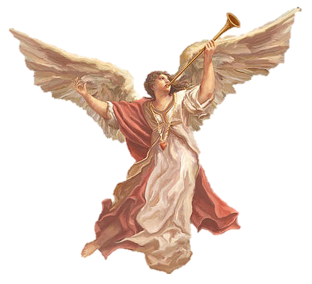
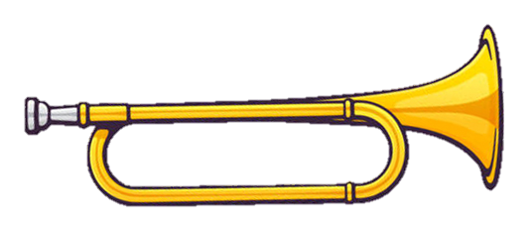
The 7th Seal Broken, Rev 8:1-2
Jesus Broke - the 7th Seal, Rev 8:1
Silence in Heaven – about ½ Hour
7 Angels, who stand before God – Given 7 Trumpets
1st
Angel
2nd
Angel
3rd
Angel
4th
Angel
5th
Angel
6th
Angel
7th
Angel
8th
Angel

Slide 4
Trumpet Judgments, 1 - 4, Rev 8
Trumpet Judgments > 1 to 4
1st Trumpet, 8:7
2nd Trumpet, 8:8-9
3rd Trumpet, 8:10-11
4th Trumpet, 8:12
1/3 Earth
Judgment
1/3 Sea
Judgment
1/3 Waters
Judgment
1/3 Heavens
Judgment

Slide 5
The 3 Woes & the Last 3 Trumpets
The 3 Woes: are the Last 3 Trumpet Judgments, Rev 8:13
The 1st Woe > is the 5th Trumpet Judgment, Rev 9:1-12
The 1st Woe is > the 1st of 3 Woes
in “Woe, woe, woe to those who dwell on the earth, Rev 8:13
“The first woe is past; behold, two woes are still coming after these things”, Rev 9:12
The 2nd Woe > is the 6th Trumpet Judgment, Rev 9:13-21
The 2nd Woe is > the 2nd of 3 Woes
in “Woe, woe, woe to those who dwell on the earth, Rev 8:13
“The second woe is past; behold, the third woe is coming quickly”, Rev 11:14
The 3rd Woe > is the 7th Trumpet Judgment, Rev 11:15 to Rev 19:21
that includes the 7 Bowl Judgments
The 3rd Woe is > the 3rd of 3 Woes
in “Woe, woe, woe to those who dwell on the earth, Rev 8:13

Slide 6
The 7 Trumpet Judgments
Jesus Broke - the 7th Seal, Rev 8:1
Silence in Heaven – about ½ Hour
7 Angels, who stand before God – Given 7 Trumpets
The 7 Trumpet Judgments
1st
Woe
2nd
Woe
3rd
Woe
1st
Trumpet
2nd
Trumpet
3rd
Trumpet
4th
Trumpet
5th
Trumpet
6th
Trumpet
7th
Trumpet
Initiated by Jesus’ Seal, from the Father, announced by Angels

Slide 7
Trumpet Judgments > 5 - 7
The Trumpet - Judgments > 5, 6, & 7
1st
Woe
2nd
Woe
3rd
Woe
5th Trumpet, 9:1-12
6th Trumpet, 9:13-11:13
7th Trumpet, 11:13-19:21
The Woe - Judgments > 1, 2, & 3
The 3 Woe Judgments: are the Last 3 Trumpet Judgments

